Slide 1

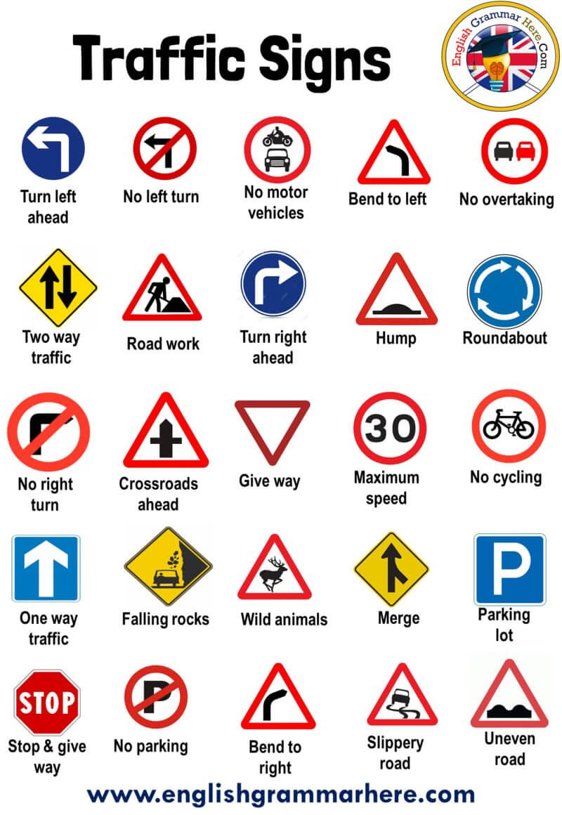
ROAD SIGN DETECTION
Presented by:-
LIKITH PATNAIK(19CSE300)
MOHHAMAD YAWAR ANIS(19CSE301)
ASHUTOSH MAHAPATRA(19CSE309)
MD HASIBUR RAHMAN(19CSE328)

Slide 2
CONTENT
INTRODUCTION
OBJECTIVE
REQUIREMENTS
PURPOSE
WORKING
DESIGN
DEVELOPMENT
SCREENSHOT
CONCLUSION

Slide 3
INTRODUCTION
Road-sign recognition (RSR) is a technology by which a vehicle is able to recognize the traffic signs put on the road e.g., “speed limit” or “children” or “turn ahead”. This is part of the features collectively called (Advance driver assistance system) ADAS. The technology is being developed by a variety of automotive suppliers.
Road and traffic signs considered in this thesis are those that use a visual/symbolic language about the road(s) ahead that can be interpreted by drivers. The terms are used interchangeably in this thesis, and elsewhere might also appear in combination, as “road traffic signs”.
They provide the driver with pieces of information that make driving safe and convenient. A type of sign that is NOT considered in this thesis is the direction sign, in which the upcoming directions for getting to named towns or on numbered routes are shown not symbolically but essentially by text.

Slide 4
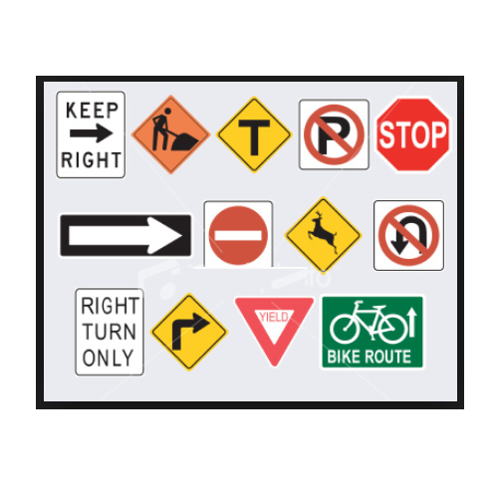
OBJECTIVE
The objectives are thus:
To understand the properties of road and traffic signs and their implications for image processing for the recognition task.
To understand colour, colour spaces and colour space conversion.
To develop robust colour segmentation algorithms that can be used in a wide range of environmental conditions.
To develop a recognizer that is invariant to in-plane transformations such as translation, rotation, and scaling based on invariant shape measures.
To identify the most appropriate approach for feature extraction from road signs.
To develop an appropriate road sign classification algorithm.
To evaluate the performance of the aforementioned methods for robustness under different conditions of weather, lighting geometry, and sign.

Slide 5
REQUIREMENTS
HARDWARE REQUIREMENTS
SOFTWARE REQUIREMENTS
A Standalone system to be installed where the system is to be used, and the road sign detection algorithm needed to be installed.
Camera of good quality for better capture of signs.
Python version 3.7 or higher to be installed.
Windows 7 or 10

Slide 6
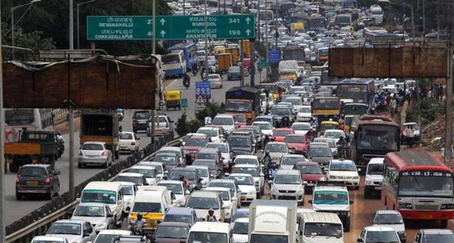
PURPOSE
The overall aim is to develop a system that can be used for traffic sign inventory. This system can assist local or national authorities in the task of maintaining and updating their road and traffic signs by automatically detecting and classifying one or more traffic signs from a complex scene (like the one shown in Figure) when captured by a camera from a vehicle. The main strategy is to find the right combination of colours in the scene so that one colour is located inside the convex hull of another colour and combine this with the right shape. If a candidate is found, the system tries to classify the object according to the rim pictogram combination and give the result of this classification.

Slide 7
WORKING
Road Sign Recognition is a field which is concerned with the detection and recognition of road and traffic signs in traffic scenes acquired by a camera. It is a technique which uses computer vision and artificial intelligence to extract the road signs from outdoor images taken in uncontrolled lighting conditions where these signs may be occluded by other objects, and may suffer from different problems such as colour fading, disorientation, and variations in shape and size.
The identification of the road signs is achieved through two main stages:
Detection
Recognition

Slide 8
1. DETECTION PHASE
In the detection phase, the image is pre-processed, enhanced, and segmented according to the sign properties such as colour or shape or both. The output is a segmented image containing potential regions which could be recognized as possible road signs. The efficiency and speed of the detection are important factors because they reduce the search space and indicate only potential regions.

Slide 9
2. RECOGNITION PHASE
In the recognition stage, each of the candidates is tested against a certain set of features (a pattern) to decide whether it is in the group of road signs or not, and then according to these features they are classified into different groups. These features are chosen so as to emphasize the differences among the classes. The shape of the sign plays a central role in this stage and the signs are classified into different classes such as triangles, circles, octagons. Pictogram analysis allows a further stage of classification. By analysing pictogram shapes together with the text available in the interior of the sign, it is easy to decide the individual class of the sign under consideration. A prototype of road 16 sign detection and recognition system is shown in Figure in page 7. The system can be implemented by either colour information, shape information, or both. Combining colour and shape may give better results if the two features are available, but many studies have shown that detection and recognition can be achieved even if one component, colour or shape, is missing.

Slide 10

DESIGN AND DEVELOPMENT
PYTHON
Python is a high-level, interpreted, interactive and object-oriented scripting language. Python is designed to be highly readable. It uses English keywords frequently where as other languages use punctuation, and it has fewer syntactical constructions than other languages.
Some of the key advantages of learning Python:
Python is Interpreted − Python is processed at runtime by the interpreter. You do not need to compile your program before executing it. This is similar to PERL and PHP.
Python is Interactive − You can actually sit at a Python prompt and interact with the interpreter directly to write your programs.
Python is Object-Oriented − Python supports Object-Oriented style or technique of programming that encapsulates code within objects.
Python is a Beginner's Language − Python is a great language for the beginner-level programmers and supports the development of a wide range of applications from simple text processing to WWW browsers to games.

Slide 11
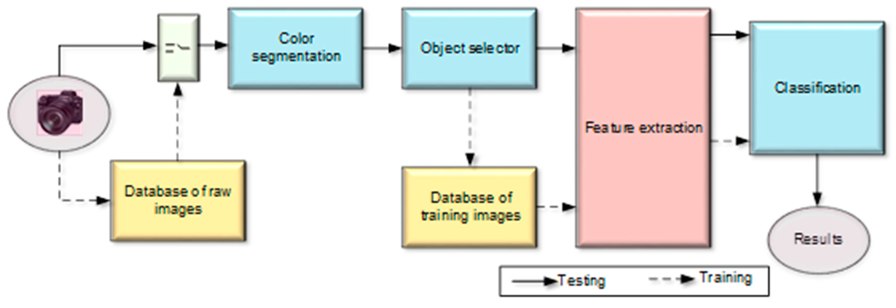
BIG IMAGE
BLOCK DIAGRAM

Slide 12

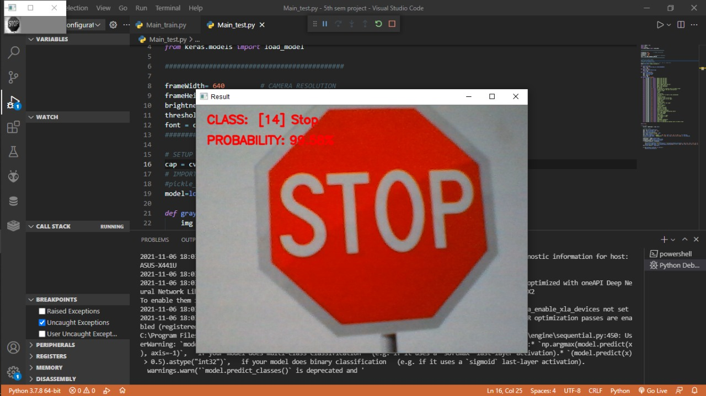
Stop sign

Slide 13
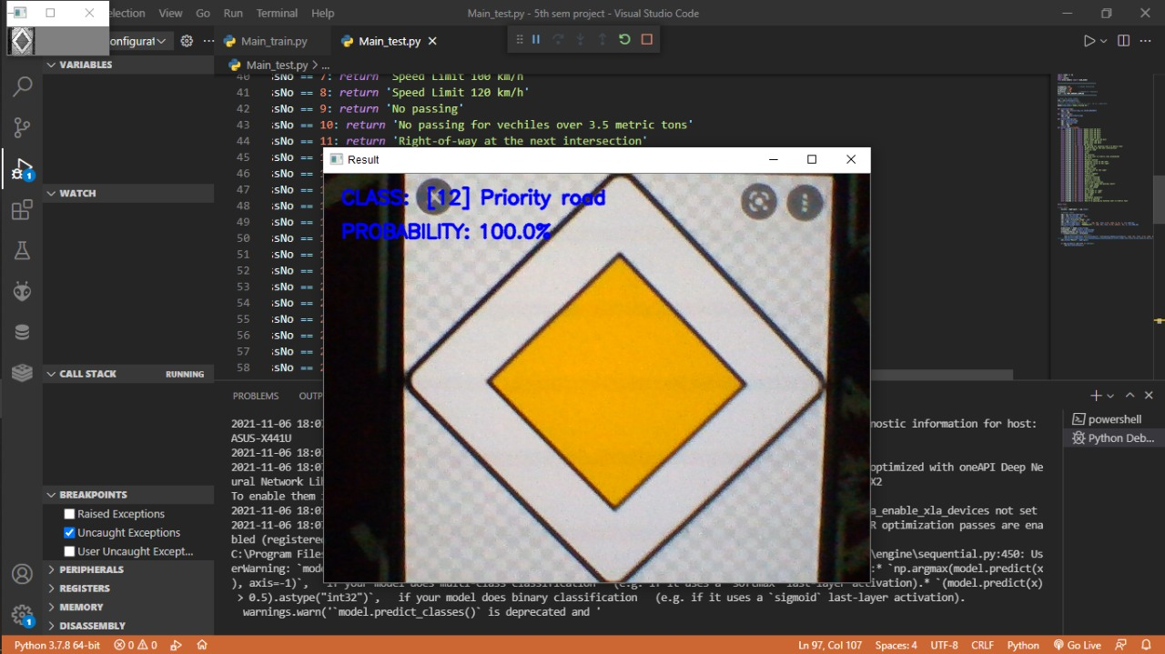
Priority road sign

Slide 14
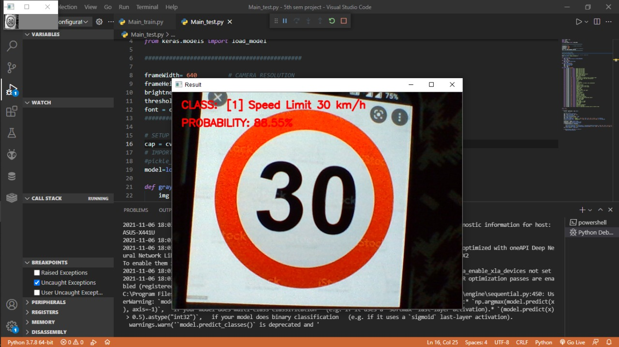

Speed limit 30 Sign

Slide 15
POTENTIAL DIFFICULTIES
In addition to the complex environment of the roads and the scenes around them the detection and recognition of these signs may face one or more of the following difficulties:
The colour of the sign fades with time as a result of long exposure to sun light, and the reaction of the paint with the air.
Visibility is affected by the weather conditions such as the fog, rain, clouds and snow.
Visibility can be affected by local light variations such as the direction of the light, the strength of the light depending on the time of the day and the season, and the shadows generated by other objects.
Colour information is very sensitive to the variations of the light conditions such as shadows, clouds, and the sun. It can be affected by illuminant colour (daylight), illumination geometry, and viewing geometry

Slide 16
CONCLUSION
Road signs recognition is a technique which uses computer vision and artificial intelligence to extract the road signs from outdoor images in uncontrolled lighting conditions where these signs may be occluded by other objects, and may suffer from different problems like fading of colors, disorientation, and variations in shape and size.
Furthermore, this system can be implemented as an alert basis for violating the traffic rules, by connecting the system to the government’s site. Such as, If any one violates the signal or traffic rule his vehicle registration number would be sent over the cloud to generate an e-challan.
Also this can be connected through IOT device for sensing dangers and accidents form a distance.

Slide 17
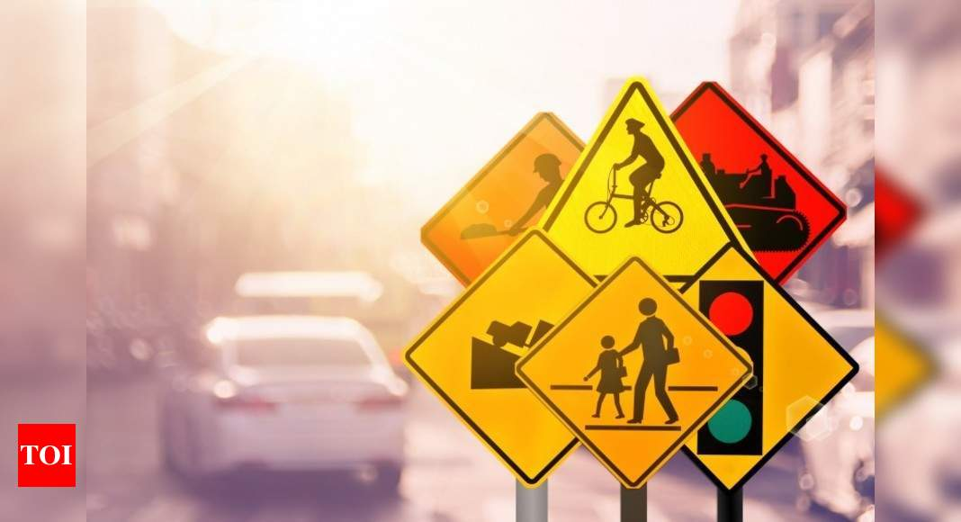
THANK YOU!

